Slide 1




Now
Knows
Green
Supply Chain
Presenting
By
Daphne Liu
Smart
e-aware

Slide 2


GREEN COPONENTS
Green Journey
e
e-aware
Knows Co2
Co2 Intelligence
Discovery

Slide 3
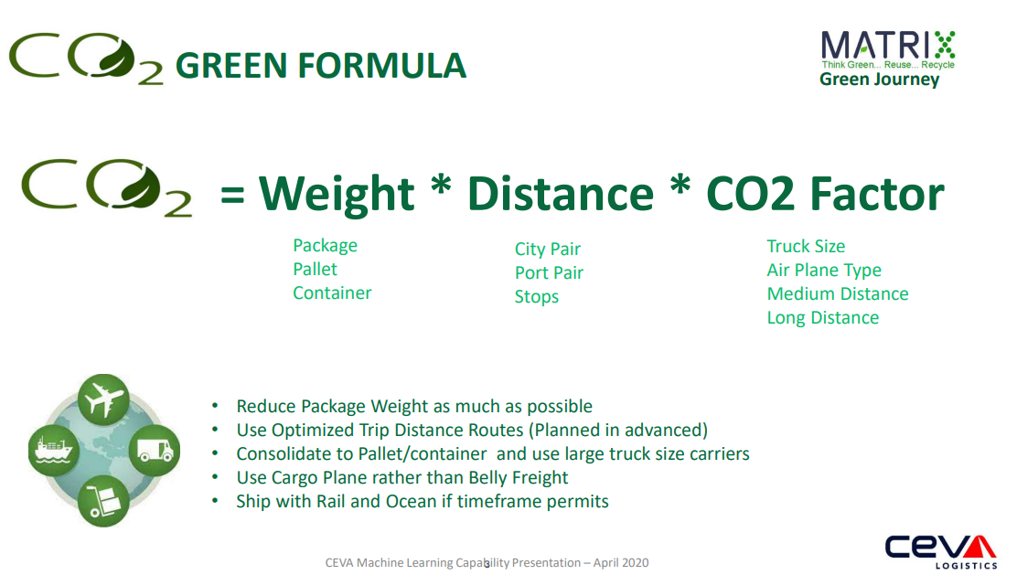

Slide 4

Green Journey
e-aware
OUR APPROACH
CO2e Reduction
Minimize CO2e by Optimized FTL Load
Replaced Air Route with Rail Ocean ones at Order/Scheduling Time
Air & Ground
Air & Ground trip consolidation opportunity alert
CO2 Green Carriers
Air
Air route with minimum stops
Top CO2 friendly airlines
Notes:
Air

Slide 5
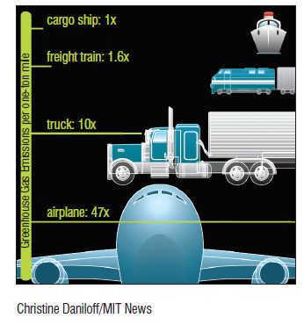
CO2e Reduction ML Model
Using CO2e emission Factors & Consolidation Algorithms
Green Journey
e-aware
Ground
Co2e emission factor (per Tonne Km ), on truck 3.5t > 7.5t > 20t > 40t
Based on cargo weight and select the minimum truck size CO2e factor
Trip consolidation algorithms based on [Origin] triggered at order level and advise consolidation opportunities
Shipping Unit Optimization from Package to Bulk/Pallet or Container
Rail route alert if city pair rail transits are available
(Smart Way for us, favorite CL)

Slide 6

Green Journey
Use Green Conscious Airlines
e-aware
Air
Co2e emission factor (per Tonne Km ), on aircraft Belly freight > Cargo plane
Prioritized air carriers from Cargo plane -> Belly freight
Prioritized air carriers by number of airport stops of each city pair
Top Co2e Airline Index
Shipping Unit Optimization from Package to Bulk/Pallet or Container
Ocean route alert if delivery date are 6 week ahead
(Smart Way for us, favorite CL)

Slide 7
Co2e Emission Intelligence
Green Journey
Knows Co2
Co2 Intelligence
Co2e Emission Indexes on Air, Ground, North America & Europe
Co2e Linear Regression Forecast Model on trend and season
Trip consolidation opportunity cluster model by OD path & Delivery Date
Co2e Emission Saving Calculator
See Dashboard Presentation
Dashboard

Slide 8
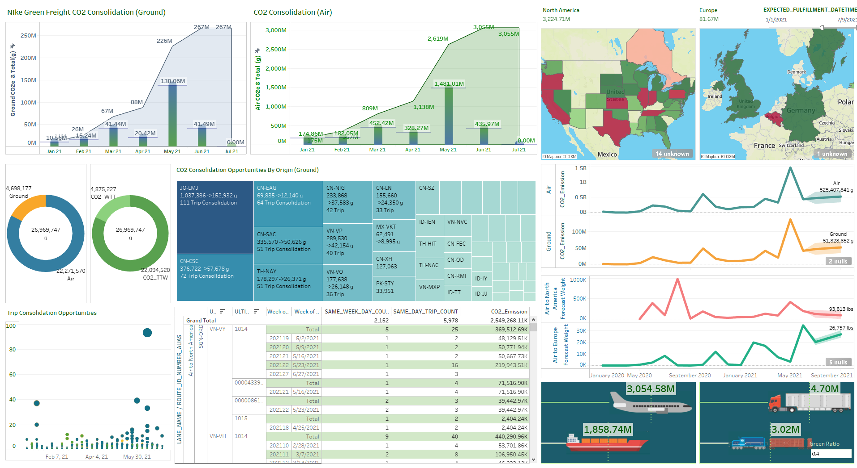
Green Journey
Knows Co2
Co2 Intelligence

Slide 9
e
Discovery
We can be more GREEN
Green Journey
City Pair based shipment CO2e discovery panel
CO2e forecast based on air/ocean port and routes
Interactive CO2 calculations driven by distance, weight & CO2e visualization
Consolidation opportunity advisor by day, week on air/ocean ports
Route wizard suggests CO2e reduction route and trip combination
Green calculator delivers optimized CO2e shipment and execution plan
Supply Chain
Smart

Slide 10
Our Challenges
Data Quality
Data Mapping
Changes in Operations

Slide 11
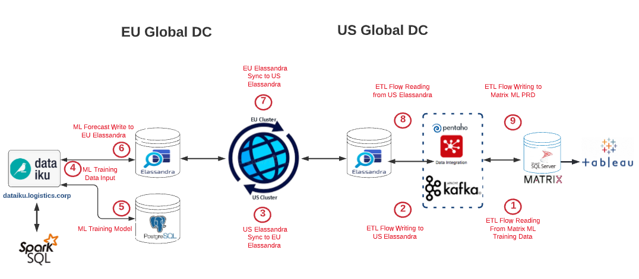
Enterprise Green Architecture

Slide 12
THANK YOU

Slide 13
TAXONOMY OF MACHINE LEARNING METHODOLOGIES IN LOGISTICS
Demand
Forecasting
Carrier
Segmentation
Feedbacks
Comments
Meaningful
Compression
Freight
Index
Sea/Air Freight
Rate & Volume
Forecast
Smart Pricing
Dimensionality
Reduction
Regression
Manpower
Optimization
Machine Learning
Big Data
Visualization
Customer
Segmentation
Green Freight
CO2 Emission
Supervised Learning
< 5 Yrs
Unsupervised
Learning
> 5 Yrs
Warehouse
Restocking
Module
Location
Fuzzy
Grouping
Cash Flow
Forecasting
Clustering
Order Risk Forecast
New Customer
Pricing Tiers
Carrier
Fuzzy
Grouping
Data
Quality
Classification
Reinforcement
Learning
> 5 Yrs
Waveless
Ops
Freight Movement
Consolidation
& Optimization
Customer
Retention
Margin
Optimization
Model
Lead Generation
Carrier Advisor
Customer Decision
Behavior
Customer
Rating
Hub Optimization

Slide 14
TAXONOMY OF MACHINE LEARNING ALGORITHMS IN LOGISTICS
Demand
Forecasting
Carrier
Segmentation
Time Series
Linear Models
Decision Tree
Concept Learning
Distance-based
Discriminative
Dynamic
Smart Pricing
Feedbacks
Comments
Meaningful
Compression
Sea/Air Freight
Rate & Volume
Forecast
Dimensionality
Reduction
Regression
Manpower
Optimization
Freight
Index
Machine Learning
Big Data
Visualization
Customer
Segmentation
Supervised Learning
< 5 Yrs
Unsupervised
Learning
> 5 Yrs
Distanced-based
Neural Network
Warehouse
Restocking
Module
Decision Tree
Concept Learning
Distance-based
Discriminative
Neural Network
Cash Flow
Forecasting
Customer
Rating
Clustering
New Customer
Pricing Tiers
Carrier
Fuzzy
Grouping
Data
Quality
Classification
Waveless
Ops
Reinforcement
Learning
> 5 Yrs
Freight Movement
Consolidation &
Optimization
Customer
Retention
Margin
Optimization
Model
Lead Generation
Carrier
Ranking
Customer Decision
Behavior
Supply Chain Modeling
Consultancy
Hub Optimization

Slide 15


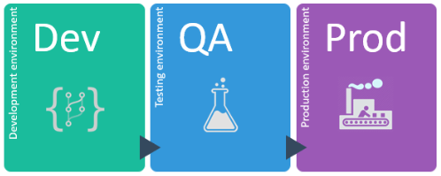

















Matrix Big Data Machine Learning Data Architecture
Data Lakehouse
Data Engineering
AutoML Training
Model Deployment
2016
Connectors
JSON Processor
JSON
2017
2018
2019
Feature
Selection
Transform
2020
Big Data Parallel Processing
Multi-Threaded Bulk Data Loading
Big Data Training Process
Trained Machine Learning Models

Slide 16












MACHINE LEARNING/AI PORTAL ARCHITECTURE
Matrix • FMS •
WMS • JSON • CSV • 3rd Party Data
Predictive Analytic
Model
Machine Learning
Algorithms
Transactional
Data
Data Lakehouse
Model
Pentaho
ETL
API enabled
Connection
Enterprise
Applications
Visualization
Machine Learning
Portal
Machine Learing
Solution Packages
Machine Learning
Modules
16

Slide 17
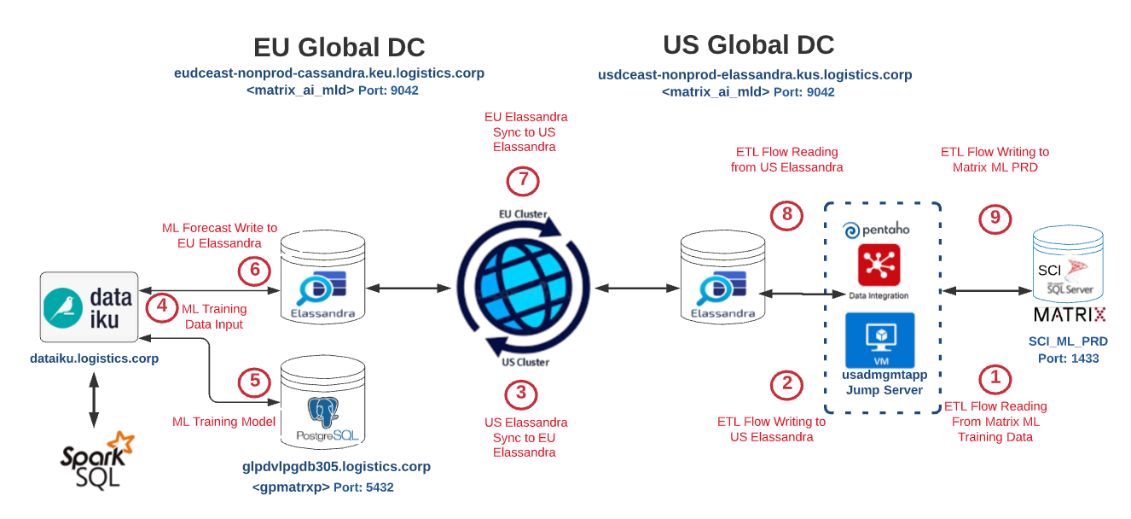
ML Data Architecture

Slide 18
Digital Platform Modules
Supply Chain
Order Risk Forecast
Freight Movement Consolidation
Green Freight CO2 Emission
Carrier Advisor
Hub Optimization
Load Forecast On Route
Freight Cost Index
Milestone Intelligence
Route Optimization
Supply Chain Intelligence as a service (SCIaas)
Machine Intelligence as a service (MIaas)
Supply Chain Smart API?
Service at Order & Scheduling level
Order Risk Analysis by City Pair, Carrier, Service Level and Seasonal Trend
CO2e Aware Advisor
Freight Movement Consolidation
Carrier Advisor
Milestone Intelligence
Freight Movement Consolidation
e-aware
Smart
Service at Network Planning
Load Forecast on Route & Lane
Hub Optimization
Freight Cost Index & Trend (FSS)

